Slide 1
Introducing a Major New Version of
The Low Emissions Analysis Platform
July 11 and 17, 2024

Slide 2
Presenters
Charles Heaps
LEAP Developer
Energy Modeling Program, SEI US
Silvia Ulloa
Researcher and LEAP Trainer
Energy Modeling Program, SEI US
Charlotte Wagner
Researcher and LEAP Trainer
Energy Modeling Program, SEI US

Slide 3
Agenda
Introducing the new version of LEAP
Overview and demonstration of new features
Q&A

Slide 4
What Is ? (A quick reminder)
A windows-based software tool for energy, climate mitigation, and air pollution planning, with a focus on scenario analysis.
Widely applied by thousands of users in almost every country at multiple scales: global, continental, national, subnational, city-scale.
Covers all fuels, all sectors, and all pollutants: including both energy and non-energy sectors.
Not just for modeling - also supports data management, results visualization and stakeholder engagement.
Promotes a needs-based and end-use oriented approach to modeling with flexible data structures, and a wide choice of modeling methods.

Slide 5
Why a New Version?
At SEI, we aim to boost energy, climate & air pollution policy-making by making policy-relevant analysis easier to undertake, more accessible, more rigorous, more credible, more inclusive, and better able to address important emerging concerns.
More than two years in the making, this new version of LEAP pushes forward over all these dimensions.

Slide 6
Introducing the New Features
Full Energy System Optimization Modeling
The LEAP Cloud Data Server (LCDS)
Powerful and easy-to-use methods for modeling holistic decarbonization pathways.
Simplifying data collection and model maintenance.
Plugins
Simpler, more modular, and more community-based model development.
Energy Affordability Analysis
A new approach for studying the affordability of pathways for marginalized communities: helping to highlight social and environmental justice concerns.
Accessibility
New translations of the LEAP user interface in 14 languages: making it more accessible and helping to improve engagement between modelers and stakeholders.
User Interface (UI)
Major revamp of the user interface making it easier and more enjoyable to use, while still being immediately recognizable for existing users.
Notes:
+ Many other improvements!

Slide 7
Where to Download ?
The new version of LEAP will be available in the next few days from the LEAP website:
https://leap.sei.org
Questions? Contact us at leap@sei.org
Or visit the new Linked Group: https://leap.sei.org/LinkedIn
Compatibility: New version is fully backwards compatible with earlier versions.
Hardware/software requirements: any standard Windows-based PC with 2 GB RAM. 32-bit or 64-bit.
Can also be used on an Apple Mac via a Windows virtual machine (e.g., VMWare Fusion or Parallels).
Use with existing LEAP License? Yes! No charge to upgrade.
Licensing: All users require a license. Licenses are available at no cost to Governments, NGOs and academics in low-income and lower-middle-income countries and substantially discounted for these users in upper-middle-income countries. Free for students worldwide.

Slide 8
A Modern User Interface
We’ve given LEAP’s user interface (UI) a major revamp: making it more professional looking, more configurable, and easier and more enjoyable to use.
We’ve also taken great care to ensure LEAP is immediately recognizable and usable by its many existing users.
The UI includes updated icons, support for the latest high-resolution monitors, better use of color, and support for both light and dark themes.
Many other UI improvements such as:
Bookmarks to make navigating within your models more convenient. Improved editing and documentation features,
An expanded “view bar” highlighting LEAP’s analysis and results visualization abilities
A brand-new online context-sensitive help system reflecting all the recent changes to LEAP.
Heat maps to help you quickly identify the most important numbers in your analysis.

Slide 9
Energy System Optimization Modeling
For may years LEAP has supported a wide choice of methods including both simulation and optimization.
Until now, LEAP was limited to doing partial optimization of only a single sector in an energy system (e.g., electric generation).
LEAP now supports full least-cost energy system optimization - taking full advantage of the capabilities of NEMO (LEAP’s companion optimization framework).
In addition to optimizing all of Transformation, LEAP can now also optimize selected demand end uses, and can model pipeline & transmission networks.
These new capabilities are important for modeling deep decarbonization & net zero pathways. For example, you can now specify overall constraints on GHGs and other pollutant emissions and calculate the least-cost energy system configuration that meets those constraints.
In the past, such capabilities have tended to be available only in highly complex and expensive modeling tools – making them impractical to apply for planners in most countries. But the new version of LEAP implements these features in ways that make them extremely straightforward to apply. For example, LEAP does not require users to specify a Reference Energy System (RES).
Optimization makes full use of the data already entered in a LEAP model – allowing you use LEAP’s scenario management and data definition language.
All results can be viewed directly within LEAP in standard formats familiar to planners.
Optimization can be conducted for specific scenarios and results compared to those calculated in simulation- or partial optimization-based scenarios.

Slide 10
Energy Affordability Analysis
Considering environmental justice implications of different energy and climate policy options is key to achieving a just clean energy transition
New Affordability Feature:
Study the affordability of policy pathways for different groups
Examine impacts on:
Total energy costs
Total device costs
Energy affordability (typical threshold is 4% of annual income)
Energy uses and prices by group
Enables specification of targeted subsidies or tariffs for specific groups, fuels, and technologies

Slide 11
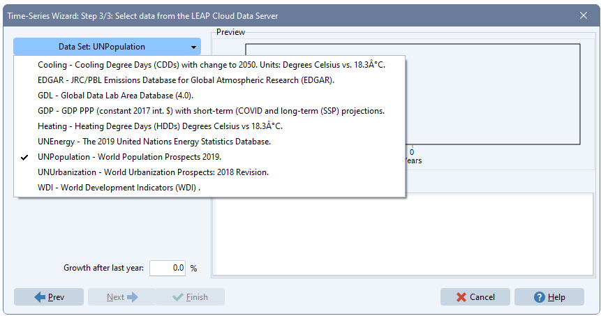
The LEAP Cloud Data Server (LCDS)
A new easy-to-use system for connecting LEAP models to an internet-hosted database containing international open-source data covering energy, emissions, and development topics.
Simplifies model development, data collection and model maintenance
Phase 1 (available): nationally-oriented statistics useful to energy modelers
Phase 2 (coming next): technology-oriented data
Notes:
The initial version provides nationally-oriented statistics useful to energy modelers including UN population prospects, UN urbanization data, UN energy statistics, Word Bank development indicators, EDGAR emissions database, KAPSARC Cooling and Heating degree days, etc.
Later, we intend to add more technology-oriented data (costs, performance, emission factors - eventually replacing LEAP’s existing TED database). The LCDS and its RESTFUL API will be open-source, and we hope that other modeling tools will also adopt it.

Slide 12
Plugins
A new modular and community-based architecture for LEAP models, streamlining model development with easy-to-integrate “mini models”.
Plugins contain suggested data structures and default data.
Helps promote standardized methodologies for modeling particular sectors or industries.
Developed and maintained by subject-matter experts and shared with the wider LEAP community via an online repository (coming soon!).
When used with LCDS can include default data that varies by country.
Notes:
LEAP 2024 introduces a new plugin architecture that allows LEAP models to be created by quickly plugging together mini models. We hope that these mini model will be developed and maintained by subject-matter experts (SEI and 3rd party) and we are creating an online repository to encourage experts to share them with the wider LEAP community. We envisage that plugins might contain standardized methodologies for modeling particular sectors or industries and would include suggested data structures and default data. When used with LEAP’s LCDS they could even include default data that varies by country. Plugins can be created in LEAP and easily shared as single data files. They should make model development easier and more modular.

Slide 13
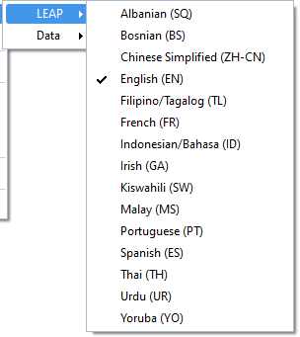
Accessibility
Translations of the UI and data structures make it more accessible and help improve engagement.
Software translations in 14 languages (more to come!)
Uses Google Translate and volunteer review.
Your own model (branch names, fuels, scenarios…) can also be Google Translated to any language and you can easily switch among languages.
Please let us know if you can review translations for more languages!
Notes:
Using Google machine translations combined with volunteer review, we’ve created new translations of the LEAP user interface to make it more accessible. We’ve prioritized translations in languages that are important in Africa and Asia – not just the standard UN languages. LEAP now also works with Google Translate to help users translate their models. Any model can be quickly switched between different languages providing more options for engagement among modelers and stakeholders. Language Translations created so far: Albanian, Bosnian, Chinese, French, Gaelic., Indonesian, Malay, Portuguese, Spanish, Tagalog, Thai, Swahili, Urdu, Yoruba. Volunteers needed for additional languages!
New translations of the LEAP user interface in 14 languages making it more accessible and helping to improve engagement among modelers and stakeholders.

Slide 14
Recap: New Features
Full Energy System Optimization Modeling
The LEAP Cloud Data Server (LCDS)
Powerful and easy-to-use methods for modeling holistic decarbonization pathways.
Simplifying data collection and model maintenance.
Plugins
Simpler, more modular, and more community-based model development.
Energy Affordability Analysis
Accessibility
New translations of the LEAP user interface in 14 languages making it more accessible and helping to improve engagement among modelers and stakeholders.
User Interface
Major revamp of the user interface making it easier and more enjoyable to use, while still being immediately recognizable for existing users.
A new approach for studying the affordability of pathways for marginalized communities: helping to highlight social and environmental justice concerns.
Notes:
+ Many other improvements!

Slide 15
What’s Next?
New version with updated training manuals and user guide in the next few days from: https://leap.sei.org
Stay tuned by joining the LEAP website, and our Facebook, YouTube, and new LinkedIn Groups.
Recording of this webinar and this PowerPoint will be shared in the coming days.
We encourage you to share your news on these platforms. We love to hear from users about LEAP-related events, reports, and papers.
Coming next year: LEAP for the web. As a desktop app, LEAP is limited in how it can be used for broad stakeholder engagement. We are threfore starting work on a new web-based tool that will let you publish your LEAP models online where stakeholders can explore your scenarios without the need to download, install or license LEAP itself.
https://leap.sei.org
https://leap.sei.org/YouTube
https://leap.sei.org/LinkedIn
https://leap.sei.org/Facebook
leap@sei.org
https://www.sei.org Find out about SEI’s other work

Slide 16
Q&A
https://leap.sei.org
If you have additional questions, contact us at leap@sei.org
Notes:
Template note:
To create a new Section Divider slide, either a) copy this slide and edit the existing text; or b) copy the white brand shape (in place) to a newly added Section Divider slide from the template library.
Due to the way PowerPoint handles layers, the brand shape on the section divider slide cannot be locked in place. Ensure that this shape is not moved, resized or otherwise altered when using this template slide. The image can be changed.
Photo credit: Getty images / yimwow https://www.gettyimages.com/license/490316478

