Slide 2
2019 Kuwait Energy Outlook
Sustaining Prosperity Through Strategic Energy Management
17 February 2019
Kuwait Institute for Scientific Research, Kuwait
Energy and Building Research Center
KISR

Slide 3
It is Time for Strategic Management …
Coordination …
Energy Planning and Policy tool
Annual national energy reference.
Addressing domestic and international energy affairs.
Assessing present situation.
Forecasting and analyzing potential future scenarios.
Discussing policy implications: technology, infrastructure, economy, geopolitics, and environment.
Energy and Building Research Center
Kuwait Institute for Scientific Research

Slide 4
Global energy trends …
Expected oil demand reduction in the long-term
USA unconventional oil and gas.
Technological development and price decrease in renewable energy.
Transition in transportation sector.
Improvement of energy efficient systems.
Climate considerations pursuing low carbon economy.
Competitive oil market
New and resuming oil producers
Shale oil.
Energy and Building Research Center
Kuwait Institute for Scientific Research

Slide 5
The Grand Challenge!
The oil sector accounts for about 90% of Kuwait’s export revenues.
Energy and Building Research Center
Kuwait Institute for Scientific Research

Slide 6
Energy Intensity
In 2015, Kuwait required over 50% more energy to generate a dollar of economic output than the OECD average.
Energy and Building Research Center
Kuwait Institute for Scientific Research
Notes:
energy intensity measures the amount of energy needed to generate a US dollar of economic output
high-energy intensity is not necessarily an unfavorable outcome for resource-rich economies - it could simply be a reflection of comparative advantage in energy-intensive industrial activities. Evidence suggests, however, that current pricing policies encourage wasteful energy consumption in ways that are damaging to the wider economy.

Slide 7
The Environmental Challenge
CO₂ Emission per Capita
Energy and Building Research Center
Kuwait Institute for Scientific Research

Slide 8
Kuwait Energy Outlook
KEO 2019
Business As-Usual Case.
Future Outlooks
Potential cases and their Economic, Geopolitical, and Environmental Implications:
Alternative energy supply mix: Nuclear, coal, hydrogen, biofuel, etc.
Energy management demand measures scenarios: Tariff, energy storage, building codes, labeling, etc.
Low GHG emission energy system technologies: Electric vehicles, carbon capture & storage, etc.
General analysis: global oil and gas demand/supply and prices, and emerging technologies.
Energy statistics precludes a more detailed and comprehensive analysis of Kuwait’s energy future.
Obtaining data and statistics would greatly improve the robustness and scope of future analyses and outlooks.
Energy and Building Research Center
Kuwait Institute for Scientific Research
Notes:
The ultimate goal for policy makers in Kuwait is the creation of a national energy balance.
Central Statistics Bureau has a critical role as the nation’s data clearinghouse.
Attention to rectifying the constraints in obtaining data and statistics would greatly improve the robustness and scope of future analyses and outlooks.

Slide 9
2019 Kuwait Energy Outlook
Sustaining Prosperity Through Strategic Energy Management
Energy and Building Research Center
Kuwait Institute for Scientific Research

Slide 10
2019 Kuwait Energy Outlook
Sustaining Prosperity Through Strategic Energy Management
17 February 2019
Kuwait Institute for Scientific Research, Kuwait
Energy and Building Research Center
KISR

Slide 11
Collaboration ...
National:
International:
Energy and Building Research Center
Kuwait Institute for Scientific Research
Notes:
Thank everyone for contributing; Otherwise the KEO would not have been produced

Slide 12
Objectives
Production of the Kuwait Energy Outlook (KEO) annually.
Strengthen the institutional capacity of the Kuwaiti professionals in the energy field.
Sustainable Development Goals (SDGs) 2030:
Kuwait National Development Plan (KNDP) 2035:
Economy
Infrastructure
Living Environment
Energy and Building Research Center
Kuwait Institute for Scientific Research

Slide 13
Editorial Committee
Energy and Building Research Center
Kuwait Institute for Scientific Research
Notes:
Will help us establish our themes for upcoming KEOs
Efficient transport
PG mix
Glimpse of material in KEO

Slide 14
Net Oil-Export Revenue Relative to GDP
Oil sector accounts for about 90% of export revenues, and net oil-export revenues in Kuwait are approximately 40% of GDP.
Net oil-export revenues in Kuwait were $46 billion in 2017.
Per capita net oil-export revenues are $11,303, the second highest in the GCC after Qatar.
Energy and Building Research Center
Kuwait Institute for Scientific Research
Notes:
If asked for Kuwait per capita approximately 36,000

Slide 15
Electricity Consumption Per Capita
In 2015, per capita electricity consumption was (14.95 MWh), close to double the average for OECD countries (8 MWh) and considerably higher than the average for GCC countries (11 MWh)**.
Air-conditioning is approximately 70% of annual peak load demand.
Reliance on oil products and natural gas for electricity generation and desalination.
Renewable energy accounts for less than 1% of energy demand.
Increasing the share of renewables to meet 15% of electricity demand by 2030.
* GCC Countries except Kuwait.
Energy and Building Research Center
Kuwait Institute for Scientific Research
* * IEA data for total electricity consumption in 2015, which includes own use.
Notes:
Per capita energy consumption among the highest in the world.
Lax energy code implementation verification, energy subsidies and a hot climate, all contribute to the growth of electricity consumption of 5% per year (average) from 2000 to 2015.
Kuwait’s per capita consumption started to decline around 2005 for two main reasons:
Stricter enforcement of building codes.

Slide 16
Kuwait LEAP Model
Utilizes IEA energy balance data.
Other data sources came from KPC, MEW, CSB, MOI, PAHW and GSSCPD.
Building a national comprehensive database for energy statistics is key.
Detailed accounting of electricity capacity and generation by plant type and accounts for energy use in oil refining and desalination.
Where possible end-use oriented approach accounting for types of energy services in Kuwait LEAP model.
Sought to characterize the end-use activities (building a bottom-up model).
Accounts for energy sector GHG emissions.
Energy and Building Research Center
Kuwait Institute for Scientific Research
Notes:
Data from everywhere was necessary
effort that took months
to complete
to collect and verify
CSB has critical role in future outlooks

Slide 17
Energy Supply
 | Oil | Gas
Downstream | Increase refinery capacity through the commissioning of capacity creep projects at Mina Abdullah refinery and Al-Zour. Build new and revamp existing Sulphur handling facilities at Mina Al-Ahmadi refinery. Build new crude and bitumen units at Mina Al-Ahmadi refinery. Commission a new acid gas removal unit and revamp the existing units at Mina Al-Ahmadi refinery. | Commission the 5th gas-processing train by 2020. Commission the new 3,000 billion British thermal units per day LNG import terminal in Al-Zour, to come online by 2021. Develop an ethane cracker by 2025. Initiate a joint venture for derivatives and specialty products.
Upstream | Increase refinery capacity through the commissioning of capacity creep projects at Mina Abdullah refinery and Al-Zour. Develop heavy-oil enhanced oil recovery programs in the north. Develop Wafra pressure maintenance programs (Phases I and II). Develop offshore and oil shale fields. | Develop 4 Jurassic production facilities by 2024, each with a capacity of 4.5 million cubic meters per day. Complete Wafra Joint Operation to capture and process associated flared gas. Construct a gas pipeline from Khafji Joint Operation to Mina Ahmadi refinery.
Energy and Building Research Center
Kuwait Institute for Scientific Research
Notes:
Kuwait is building up and reinvesting in its infrastructure; MAKING oil sector more competitive.
Crude oil production in Kuwait is expected to increase from 2.7 mb/d in 2017 to 3.5 mb/d in 2035, growing at an average rate of 1.5% per year.
Natural gas production increases, on average, by 2.5% per year, from 17.4 bcm in 2017 to 27.3 bcm in 2035.
In the Business-as-Usual Case, crude oil production in Kuwait is projected to be 3.5 million barrels per day in 2035, based on the country’s plans to increase capacity to 4 mb/d in the next decade.

Slide 18
Total Primary Energy Demand
The share of oil steadily declines from 52% in 2015 to 42% in 2035.
Natural gas demand grows by 2.2% per year in 2015 – 2035.
The share of gas climbs to 55% in 2035, up from 48% in 2015.
In the Business-as-Usual Case, the share of renewable energy demand remains low, only 3% in 2035.
Energy and Building Research Center
Kuwait Institute for Scientific Research
Notes:
Natural gas production is projected to grow from 17.4 billion cubic meters in 2017 to 27.3 bcm in 2035.
Much of the increase will be targeted to the oil and power generation sectors.
Domestic supply, however, will be unable to meet the expected increase in demand, and liquefied natural gas imports are expected to continue to be an important source of natural gas supply over the Outlook period.

Slide 19
Total Final Energy Consumption by Sector
From 2000 to 2015, growth in final demand was considerably more rapid (4.8% per year) due to a construction boom over the period and a rapid increase in population.
Total final consumption increases from 18.4 Mtoe in 2015 to 28.6 Mtoe in 2035, by an average annual rate of 2.2%
Energy and Building Research Center
Kuwait Institute for Scientific Research
Notes:
Growth in GDP and population, however, is expected to slowdown over the Outlook period.
The residential and services sectors will account for 18% of total final consumption. Non-energy use will capture 16% and the desalination sector, 6%.
The industry sector will still account for the largest share of final energy consumption in 2035, some 31%.
demand for energy in the transport sector grows by 3% per year on average, the fastest of all sectors, and the share of transport energy demand, all oil products, in total final energy consumption will be 30% in 2035.

Slide 20
Power Generation Capacity
Electricity generation capacity in Kuwait increases to 32 GW in 2035.
In 2035, combined-cycle plants accounts for 61% of total generating capacity, steam-fired plants for a further 19%, and open-cycle gas turbine for 4%.
Renewable energy capacity, mostly solar, will make up 16%.
Energy and Building Research Center
Kuwait Institute for Scientific Research

Slide 21
Shares of Water Production by Technology
MSF: Multi-stage Flash
MED: Multiple-effect distillation
RO: Reverse Osmosis
Energy and Building Research Center
Kuwait Institute for Scientific Research
Notes:
Worldwide, reverse osmosis accounts for about 65% of desalinated water production.

Slide 22
Residential Electricity Consumption
Residential electricity demand grows by 1.2% per year, from 27.2 TWh in 2015 to 34.4 TWh in 2035.
Considerably slower than growth of 5% per year in 2000-2015.
Oil products, kerosene and LPG, account for only 7% of total demand in 2035.
Energy and Building Research Center
Kuwait Institute for Scientific Research

Slide 23
Transport Oil Demand by Fuel
Transport sector grows by 3% per year on average.
The vehicle fleet in Kuwait is expected to more than triple by 2035.
Share of SUVs in the private passenger vehicle stock was less than 40% in 2015 but is projected to be approximately 60% in 2035.
Energy and Building Research Center
Kuwait Institute for Scientific Research

Slide 24
CO₂–Equivalent Emissions by Sector
Total GHG emissions increase from 83 million tonnes of CO₂-equvialent (Mt CO₂-eq) in 2015 to 103.4 Mt CO₂-eq in 2035.
Switching from oil to natural gas and renewable energy in the power sector results in a modest decline in emissions, from 44.6 Mt CO₂-eq in 2015 to 41.4 Mt CO₂-eq in 2035.
GHG emissions in the demand sectors increase from 27.2 Mt CO₂-eq in 2015 to 45.4 Mt CO₂-eq in 2035, at an average rate of 2.6% per year.
Energy and Building Research Center
Kuwait Institute for Scientific Research
Notes:
Industry sector emissions rise by 2.2% per year, reaching 21.8 Mt CO₂-eq in 2035
Transport sector is the largest contributor to rising greenhouse-gas emissions
10.4-Mt CO₂-eq increase in emissions outstrips increases in all other sectors.

Slide 25
Emissions per Capita
2035
Per-capita GHG emissions fall slightly in Kuwait, from 21.1 tonnes of CO₂ per capita (tCO₂/k) in 2015 to 20.2 tCO₂/k in 2035.
Still far greater than the world average, the average in European Union and Middle East countries over the Outlook period.
Energy and Building Research Center
Kuwait Institute for Scientific Research

Slide 26
Recommendations
Kuwait’s White Paper on a Sustainable National Energy Strategy in 2017.
Establishment of national champion.
Improve level of coordination between ministries, regulatory agencies, infrastructure operators, and service providers.
Kuwait has vast potential for improvements in energy efficiency through actionable national energy efficiency plans, incentive/rebate programs and subsidy reduction.
Energy efficiency measures offer the least-cost pathway to energy and GHG emission reductions and to an increase in energy security.
Kuwait’s substantial renewable energy potential is still largely untapped.
The development of Shagaya renewable energy plant could potentially catalyze a movement to more sustainable energy future.
To achieve meeting the target of 15% electric energy demand, opening up more sites for renewable energy as well as investing in energy efficiency programs are of paramount importance to Kuwait.
Data (accurate and detailed) is key for future outlooks and analyses.
Energy and Building Research Center
Kuwait Institute for Scientific Research

Slide 27
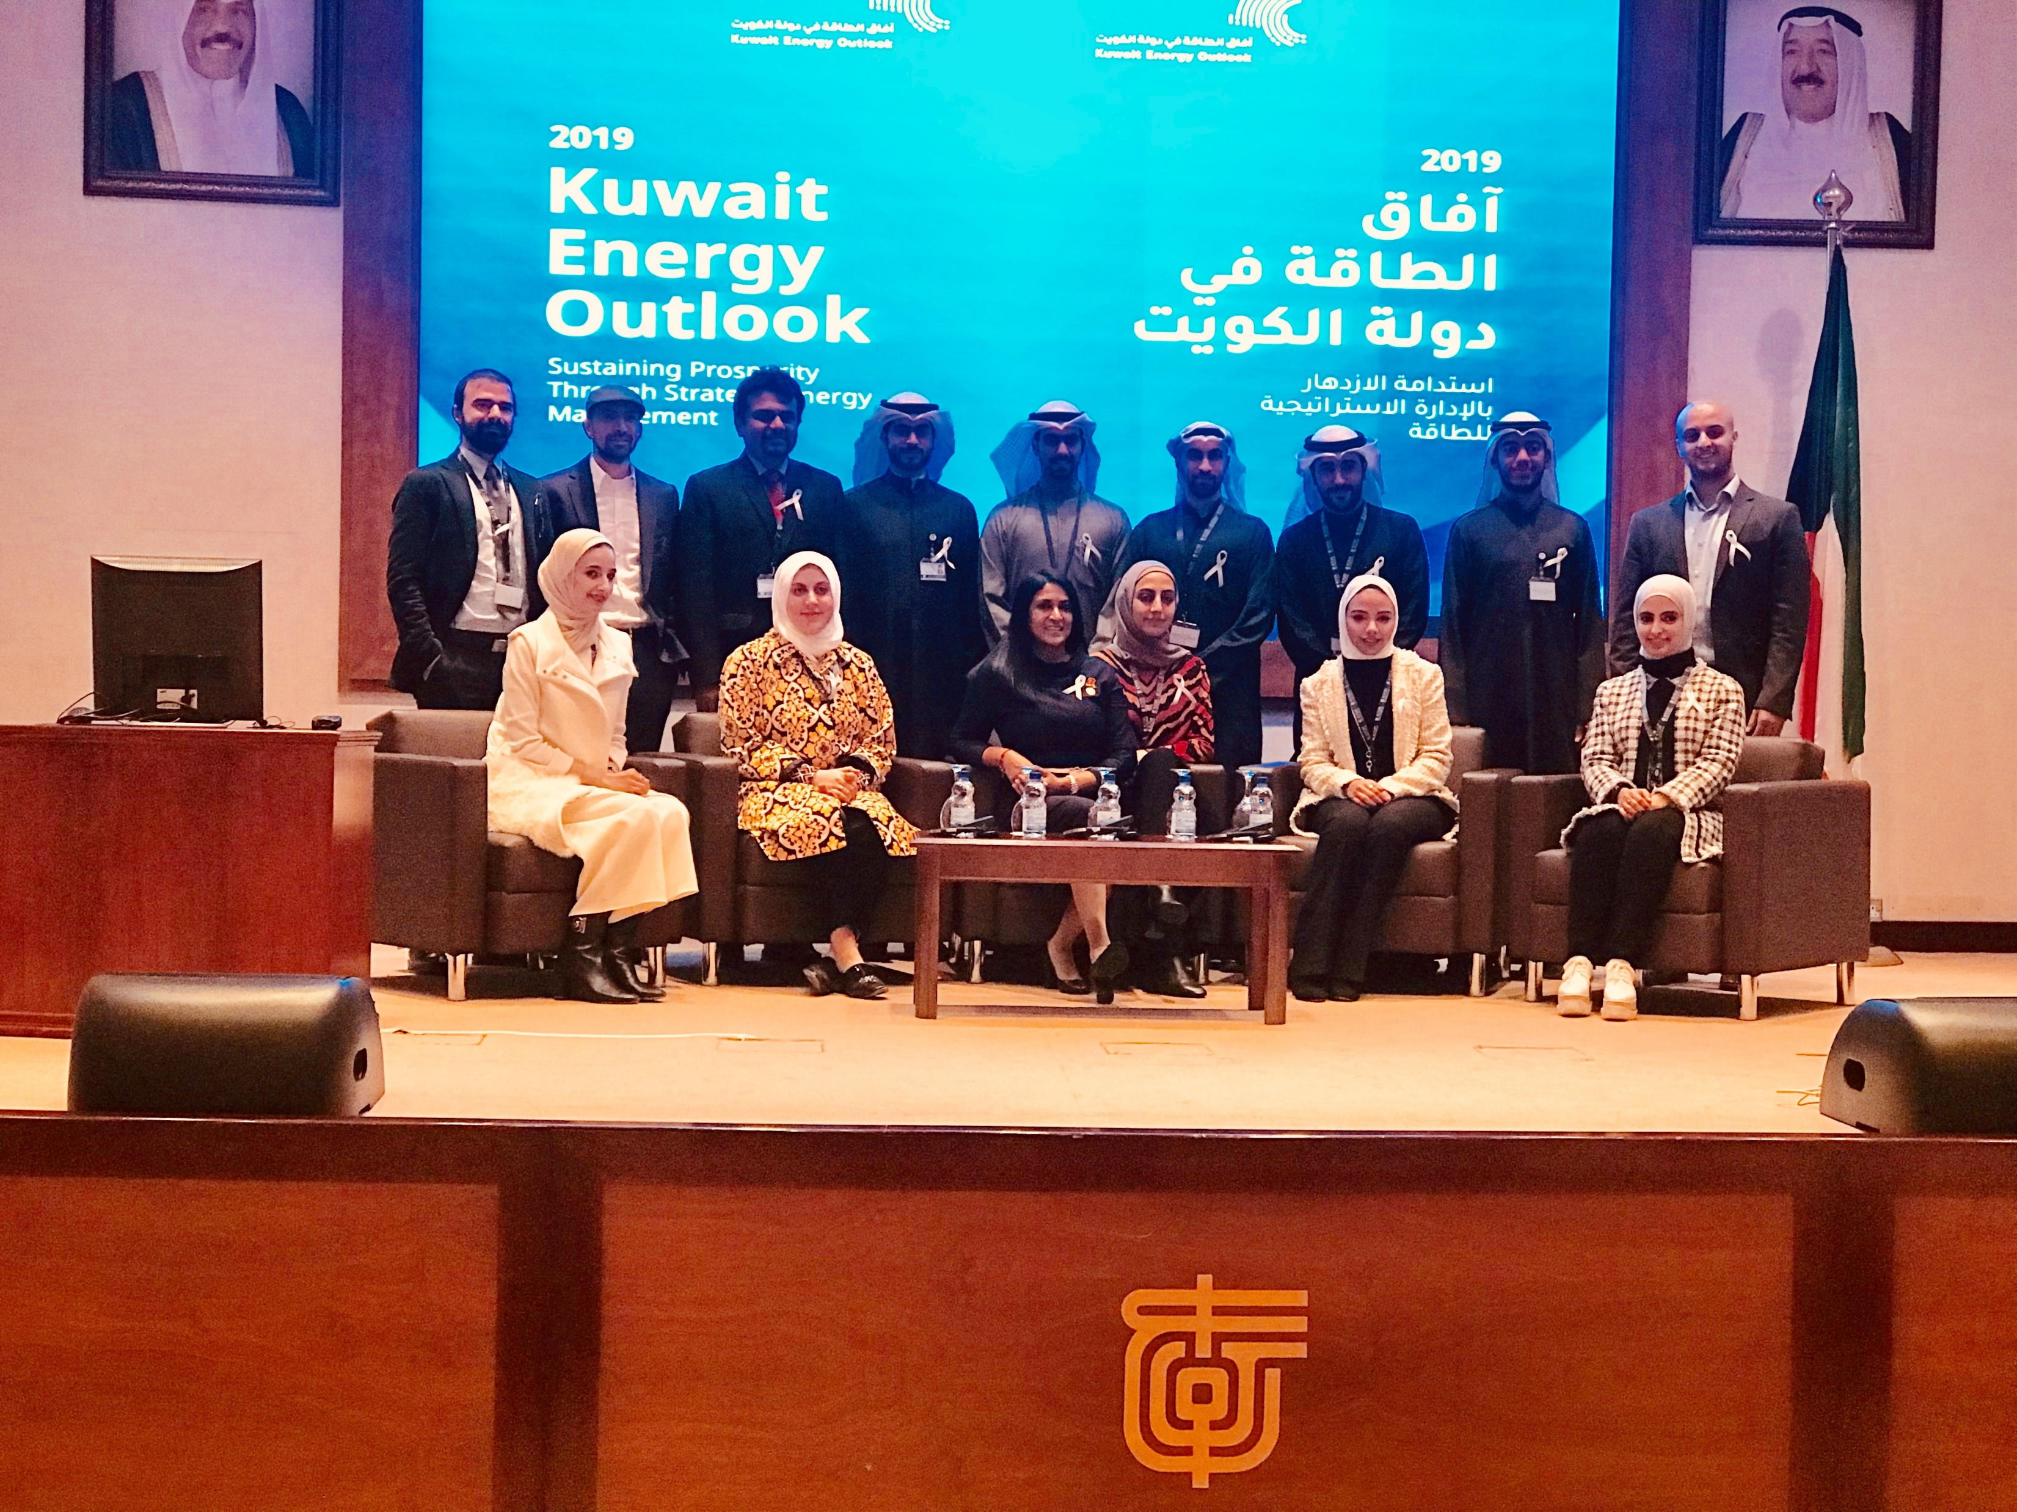
Project Team
Energy and Building Research Center
Kuwait Institute for Scientific Research

Slide 28
2019 Kuwait Energy Outlook
Sustaining Prosperity Through Strategic Energy Management
17 February 2019
Kuwait Institute for Scientific Research, Kuwait

